Slide 1
Agile Training
June 2020
Jim Grohman, Debbie Sanger

Slide 2
There is nothing mysterious or special about Agile
It is a Project Management Approach with several Associated Methodologies
If you know Waterfall Project Management you can quickly learn the language and be successful in Agile and Scrum
If you haven’t done Waterfall Project Management, you can quickly learn a few concepts and definitions and be successful in Agile as long as you can build relationships, can plan and can solve problems

Slide 3
Building Blocks
Retrospective: Continuous Improvement
Review
Backlog Grooming: Story Writing
Daily Stand
Sprint Planning: Capacity and Tasking
Sprint 0 and Getting Started
Scrum Master
Team Ceremonies
Business Analyst/ Product Owner
What is Scrum?
What are the Roles and Responsibilities
What are the Ceremonies?
What are the tools
What is Agile?
Compared to Waterfall
When is it appropriate to leverage Agile methodology?
What do we need to leverage Agile effectively?
How should we approach Agile opportunities?
June 2020

Slide 4
Traditional Waterfall Driven Development
Waterfall
  Requirements are well defined up front
  Development is sequential in one single pass
  Changes should be minimal
  Well suited for projects you have “done before” e.g. creating the same products repeatedly
  Tangible output at the end of each stage
  Ability to visually see and communicate a target delivery date based on agreed scope
“The implementation…is risky and invites failure”
Dr. Winston Royce, 1970
June 2020
Kenway Consulting
4
Notes:
The Waterfall approach has been used for many years, and sometimes it was very successful.
It works best on those projects where the requirements are well defined up front or the project is sequential and not subject to change
Because development is sequential in one single pass, the Waterfall approach is best suited to projects that have been done before such as building a spec home, or infrastructure projects like upgrading servers.
As the competitive landscape has changed over the years, there have been fewer and fewer projects that have stable requirements, have been done before, and using technology that is well understood. Most of the projects I have led have had evolving and changing requirements. I was taught to use aggressive “change control” to manage or prevent change. Unfortunately, that mechanism often led to conflict with the customer, and inhibited them from getting the system they needed.
The waterfall method makes sense from an intellectual point of view. It is logical and step by step. We will write down everything we need to do in each phase, and then we will do it. “Plan the work, work the plan” describes this line of thinking. I think it appeals to most project managers who believe that with the right plan, we can accomplish nearly anything.
Talk through the sequential process, and what happens when there are changes or discoveries of new information.
Talk about when it works well.

Slide 5
Cone of Uncertainty in Waterfall approach
This is just a fancy way of saying that at the beginning of a project you know less, so does it really make sense to try a clarify everything as far as requirements and what the end product will look like? An agile mindset and approach says no…
Degree of Error
Product Milestones
June 2020
Kenway Consulting
5
Notes:
At the beginning of a project, when a product or solution’s definition is less refined, there may also be significant uncertainty in the project cost and schedule estimates.
There are a couple of factors that lead to this high degree of uncertainty:
The less experience that the project team has with similar projects, the more uncertainty there will be in creating estimates for a project.
At the start of a project, the product or solution is typically not very well defined. Estimates will continue to change, and likely become more accurate, as the definition becomes clearer and more focused.
At project completion, all the uncertainty has been removed – the team knows exactly how much was spent.
When you plot the uncertainty against time, it looks like a cone, which is why Barry Boehm called this challenge the "cone of uncertainty".

Slide 6
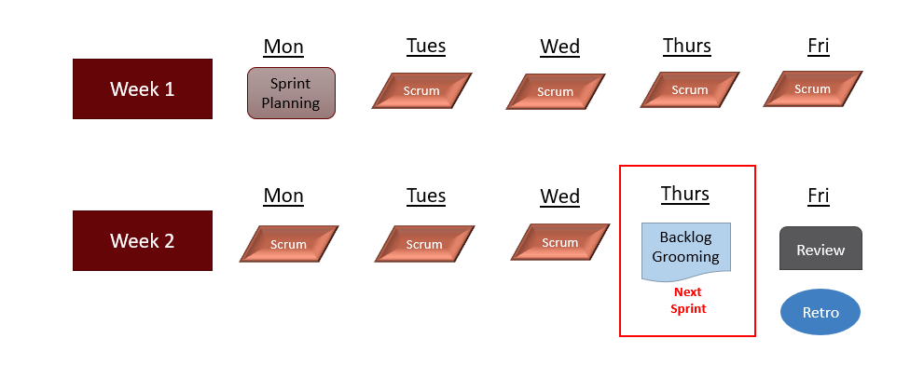
Agile for Sequential vs. Overlapping Development
Rather than doing all of one thing at a time...
Effort
Test & Deploy
Code
Design
Requirements
Agile teams do a little of everything all the time
Time
Source: “The New New Product Development Game” by Takeuchi and Nonaka. Harvard Business Review, January 1986.
June 2020
Kenway Consulting
6
Notes:
For a typical traditional software project the requirements move as a block through each development stage. Each stage of work will go on for a large amount of time– somewhere in the order of weeks or months.
For example, on traditional software development with schedules like this: one month of analysis, one month of design, two months of coding, one month of testing and putting it all together in order to deploy it. In the traditional software development, the system is only available at the end of the last stage.
For Agile software development the small pieces of requirements are constantly and consecutively moving through each development stage. And each small piece of the overall requirements spends a short amount of time on each stage; somewhere on the order of hours or days.
For example, a small requirement would be in analysis for one or two days. Next the user story would be tasked by the developers in an hour or so; while tasking they would make some small design decisions. Once tasked, the user story would move to the coding stage for typically two days, with another day for testing.
In Agile software development, the system is incrementally made available.

Slide 7
When to Use Agile vs Waterfall – Opinion Based and Subjective - However
Agile
Iterative
Uncertainty
Waterfall
Clarity
Linear

Slide 8
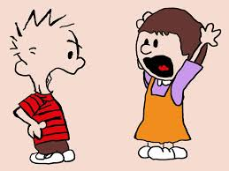
Key Differences between Waterfall and Agile
Agile: They don’t know exactly what they want, needs to be morphed as we go, need to see something to react and then decide which way we go…
Waterfall: We know almost all of what we need and where we need to be, we’ve implemented a software solution a million times and this is the next one...
As consultants we should not treat one as good or bad versus the other. We should see them both as beneficial. We should honor the beliefs of the stakeholders as we try to influence their thinking in order to have the ability to implement the right approach given the circumstances.
June 2020
Kenway Consulting
8

Slide 9
12 Agile Principles
Our highest priority is to satisfy the customer through early and continuous delivery of valuable software.
Welcome changing requirements, even late in development. Agile processes harness change for the customer's competitive advantage.
Deliver working software frequently, from a couple of weeks to a couple of months, with a preference to the shorter timescale.
Business people and developers must work together daily throughout the project.
Build projects around motivated individuals. Give them the environment and support they need, and trust them to get the job done.
The most efficient and effective method of conveying information to and within a development team is face-to-face conversation.
Working software is the primary measure of progress.
Agile processes promote sustainable development. The sponsors, developers, and users should be able to maintain a constant pace indefinitely.
Continuous attention to technical excellence and good design enhances agility.
Simplicity--the art of maximizing the amount of work not done--is essential.
The best architectures, requirements, and designs emerge from self-organizing teams.
At regular intervals, the team reflects on how to become more effective, then tunes and adjusts its behavior accordingly.
June 2020
Kenway Consulting
9

Slide 10
Agile is a Mindset and Scrum is a Methodology
There is nothing mysterious about Agile
It is a Project Management Methodology
If you know Waterfall Project Management you can quickly learn the language and be successful in Agile
If you haven’t done Waterfall Project Management, you can quickly learn a few concepts and definitions and be successful in Agile
The purpose of this Brown Bag is to try and convince you the above is true and
To take first steps to introduce the concepts and definitions
Agile is a Mindset
Individuals and interactions over processes and tools
Working software over comprehensive documentation
Customer collaboration over contract negotiation
Responding to change over following a plan
Scrum is a Methodology
Inspect and adapt feedback loops to cope with complexity
Decision making from real-world results
Short work cadences, known as sprints
Working prototype at every stage
Agile Approach
Scrum Methodology
Team
Implementation
June 2020

Slide 11

Environmental Factors for Success
In order to ensure any team can successfully deliver, we need to start with the right environment:
Clear ownership of decision-making, roles and responsibilities, and accountability and responsibility are well defined
Clear definition of business objectives and what success means
Changes against the plan are articulated, agreed upon and the rest of the plan is adjusted in response
Resources with required experience and skills are identified and have capacity required to meet the defined needs of the project
Story map and stories document the business requirements and are agreed to by the decision makers using the appropriate scrum ceremonies.
If there are multiple workstreams, scaled agile and program management is employed to ensure alignment and dependencies are identified and coordinated
Organization and leadership support increasing maturity in the execution and adherence to the scrum process and agile mindset.
There is a focus on a single team to demonstrate success, implement change management, and have an example of good for broader implementation in the future.
All Projects
Agile

Slide 12
When a client requests help with Agile
Waterfall
Agile
Companies are at various stages of learning and implementing Agile – this can often lead to confusion
As we are taking on new work ASK QUESTIONS – in this state of growth it’s very likely that we are all using vocabulary differently based on where we sit on the growth trajectory
The biggest question: The client asked for a “SCRUM MASTER” what do they really want? (what do they mean?), for example:
Is the scrum master accountable for the team’s sprint by sprint performance?
Would you expect the scrum master to set priorities and do other activities like planning and RAID log in support of the team?
Mature team and immature organization
Mature team and organization
Immature team and organization
Immature team and mature organization

Slide 13
There are Several Agile Methodologies
Agile came first as a concept and then several implementations were created:
  Lean Software Development:
    The application of Lean principles and some use of 22 tools for software development.
  Kanban:
    Provides a visual process management system which aids decision-making about what, when, and how much to produce.
  Extreme Programming (XP):
    Advocates for frequent "releases" in short development cycles, which is intended to improve productivity and introduce checkpoints at which new customer requirements can be adopted.
  Dynamic Systems Development Method (DSDM):
    Agile Project Framework covers a wide range of activities across the whole project lifecycle and includes strong foundations and governance.
  Feature Driven Development (FDD)
    Large team methodology that uses a five step process that focuses on delivering a specific piece functionality or features.
  SAFE
    Set of organization and workflow patterns intended to guide enterprises in scaling lean and agile practices.
  Scrum
    framework for developing, delivering, and sustaining complex products.

Slide 14
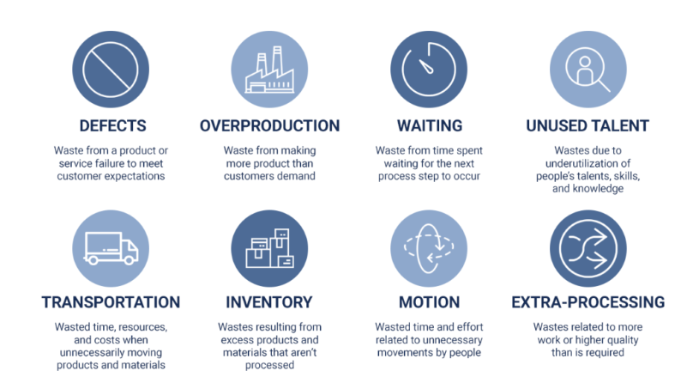
Lean and Scrum
You can use Lean principles, just like you use Agile principles in support of the Scrum Methodology.
Lean Management philosophy inspired by Toyota system practices and results is characterized by a process structure where there is an attempt to minimize risk and waste while maximizing customer value.
  Minimize work in progress – resources should have only one story open at a time.
  Minimize defects – peer and code review.
  Minimize waiting and unused talent – each story in the current sprint should be free of unmet dependencies, can be worked on immediately.

Slide 15
What is Scrum?

Slide 16


How the Work Gets Defined and Done
2 weeks
Story Board
Scrum is the most popular ‘Framework’ for Agile and is a often viewed as the preferred Project Management approach
Scrum features 2-4 week time-boxed iterations, called Sprints
  Deliver complete features at the end of each sprint
  Teams predict work for each sprint.
  Lessons learned every sprint
  Highly disciplined!
Sprint Review
Sprint Board
Backlog
Sprint
June 2020

Slide 17
Scrum Ceremonies are Necessary to Ensure the Rigor of Traditional Project Planning
Backlog Grooming
Detailed Requirements
Completion and Clarifying the User Story, Story Pointing
Sprint Planning
Project Planning
Capacity, Assignment, Tasking, and Hours Estimates
Daily Scrum
Status Meeting
Yesterday, Today, and Blockers
Sprint Review
Business User Acceptance
Show the Working Prototype
Retrospective
Project Debrief
Continuous Improvement
Initiation
Planning
Execution
Monitory and Control
Close
June 2020

Slide 18
Scrum Tactics to Solve Common Project Issues
Scope Definition
Progressive Elaboration to Refine Requirements
Estimates & Capacity
Progressive Elaboration of Scope to Quantify Capacity Needs
Transparency into Work Status
Daily Stand-Up
Story Board to Sprint Board to Stories
Formal Sprint Reviews
Two Views into Work: Story Points and Tasking
Sprint Burndown
Story Board Updates
Velocity History
Team Commitment & Ownership
Story Map Sprint Review
Sprint Burndown
Retrospectives to improve Accuracy of Estimates and Consistent Delivery
Retrospectives to improve Accuracy of Estimates and Consistent Delivery

Slide 19
Scrum Roles – the scrum team
Product Owner
Decides what will be built and in which order
Defines the features of the product or desired outcomes of the project
Chooses the release date and content
Ensures ROI
Adjusts features and priority as needed
Accepts and rejects results
Facilitates Scrum Planning
Scrum Master
Ensures the the team is fully functional and productive
Enables close cooperation across all roles and functions
Removes barriers
Shields the team from external interferences
Ensures that the Scrum process is followed
Facilitates the Daily Scrum
The Development Team
Is cross functional
Is right sized (7 +/- 2 members)
Selects the sprint goals and specify work results
Has the right to do everything within the boundaries of the project guidelines
Prioritizes itself and work
Demos work results to the product owner and any other party
June 2020

Slide 20
Scrum Roles – Others who support
Often there is a need for other skills on a team, though not always on a full-time basis.
Subject Matter Experts
Usually the business or end users
Provide expertise
Support Product Owner & Team
Technical Specialists
Architects
DBA
UI Design
Performance Testing
Leadership
Support the Team
Provide big picture coordination
Cast Vision
Remove external impediments
June 2020

